Slide 1
Marketing Operations
Overview of Eloqua Sales Tools (Engage & Profiler)
Presented by
The Lead Optimization Team
07 August 2024

Slide 2
Agenda
Welcome
Introduction – Leads Optimization Team
Usage of Eloqua Sales Tools (Engage & Profiler)
Open Q&A/Discussion

Slide 3

Marketing Operations Open Office Hours
Get your questions answered by the marketing automation team. MA Open Office Hours are held monthly with the following agenda:
  Learn about a tip or best practice
  Ask a question – Pre-submit your questions here or ask during the office hours
  Learn how to leverage IQVIA’s marketing systems and processes most effectively
Action: Sign up here, if you need to be added to the outlook invite
Reminder: Save your questions for the end or enter in the chat. We will address as many as we can!

Slide 4
Introduction to the Team

Slide 5





Lead Optimization Team - Overview
Barathi Subramaniam
Associate Director – Lead Optimization
United Kingdom.
Swathi C S
Associate Manager, Lead Optimization
Bangalore, India
Our Lead Optimization Team is dedicated to refining lead management processes, boosting conversion rates, and fostering collaboration between marketing and sales.
Our objective is to guarantee that our marketing team adequately supports the sales team, ensuring their efforts are focused on the most promising opportunities.
Salesforce Reporting and Analytics
Provide comprehensive Salesforce reporting and analytics to our inside sales team upon request.
Data Enrichment
We gather company-level and contact-level information from various data sources such as Zoominfo, Zymewire, Salesforce, Eloqua, and more.
Optimize
lead management processes
Improving conversion rates
Campaign Planning and Strategizing
We bring their expertise to the table to help design effective sales campaigns that resonate with our target audience.
Lead Scoring for Mid-Accounts
We also help with lead scoring for Mid-Accounts by analyzing various factors, we prioritize leads that have a higher probability of conversion, ensuring our sales efforts are directed towards the most promising opportunities.
Collaboration between the marketing and sales teams
CRM Automation
Assist the inside sales team with CRM automation by coordinating with the CRM governance team.

Slide 6
Eloqua Profiler & Engage

Slide 7
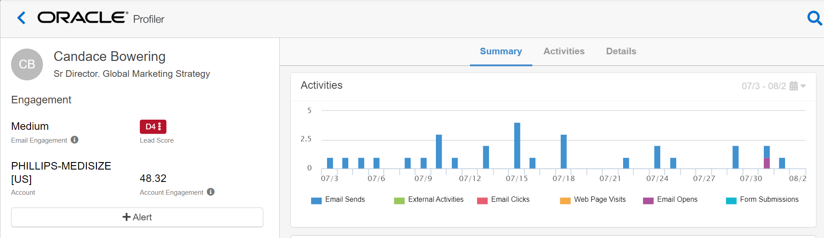
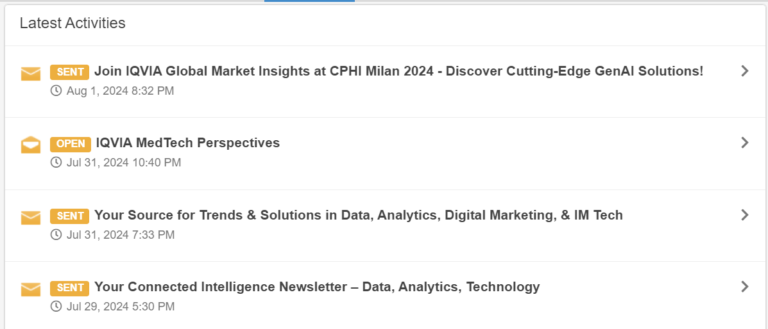
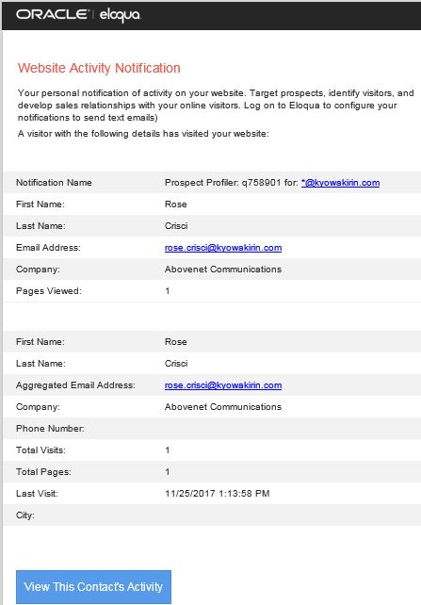
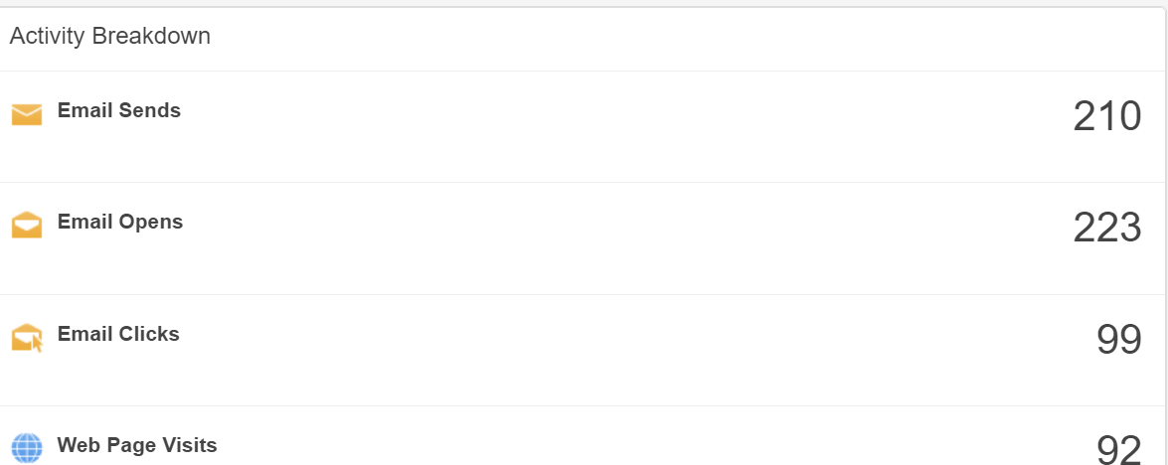
Eloqua Profiler (embedded within Salesforce)
Customer 360 View provided to the Sales Team
Oracle Eloqua Profiler is an essential tool for sales and marketing teams looking to gain deeper insights into their contacts and improve their engagement strategies.
online activities & behaviors
    Website activity
    Event and tradeshow activity
    Email Open & Click activity
    Form fill activity
Provide real-time email alerts to sales of prospect visits to IQVIA.com
Customer Insight provided to the sales team for each contact and lead
EXAMPLE NOTIFICATION
Notes:
The second tool is Eloqua Profiler, which also lives within Salesforce. Eloqua Profiler can be
used to provide visibility into prospect activity data and to send alerts on return prospect visits
to IQVIA.com or other IQVIA web properties. This is specifically helpful to the Sales team to
view customer activity data and to see previews of what emails and web pages contacts are
engaging with.
You are also able to gain visibility into contacts’ engagement with marketing tactics, some
examples of those are, event and webinar activity, open and click activity, and form fill out
activity.
So those are the main Eloqua Sales Tools that exist for you to utilize whenever needed. As a
reminder you will need an active user account in both Salesforce and Eloqua to use the tools.
You can find more details and trainings on the tool available in the resource section of our
marketing automation toolbox.
Now over to Garrett to finish up…

Slide 8
Eloqua Profiler (embedded within Salesforce)
Key Features
Benefits
Contact Details: View comprehensive information about your contacts, including their engagement history.
Activity Tracking: Monitor the activities of your contacts, such as email opens, website visits, and form submissions.
Mobile Accessibility: designed specifically for use with iOS and Android devices, giving marketers and sales reps the option to access Oracle Eloqua's Profiler functionality from their mobile devices when they are on-the-go.
Integration: Profiler can be embedded into various CRM systems like Salesforce, providing seamless access to contact information within your existing workflows
Enhanced Productivity: Streamlines access to critical contact information, saving time for sales and marketing teams.
Improved Engagement: Provides insights that help tailor communications and improve customer interactions.
Data-Driven Decisions: Offers detailed analytics to support strategic planning and decision-making.
Notes:
The second tool is Eloqua Profiler, which also lives within Salesforce. Eloqua Profiler can be
used to provide visibility into prospect activity data and to send alerts on return prospect visits
to IQVIA.com or other IQVIA web properties. This is specifically helpful to the Sales team to
view customer activity data and to see previews of what emails and web pages contacts are
engaging with.
You are also able to gain visibility into contacts’ engagement with marketing tactics, some
examples of those are, event and webinar activity, open and click activity, and form fill out
activity.
So those are the main Eloqua Sales Tools that exist for you to utilize whenever needed. As a
reminder you will need an active user account in both Salesforce and Eloqua to use the tools.
You can find more details and trainings on the tool available in the resource section of our
marketing automation toolbox.
Now over to Garrett to finish up…

Slide 9
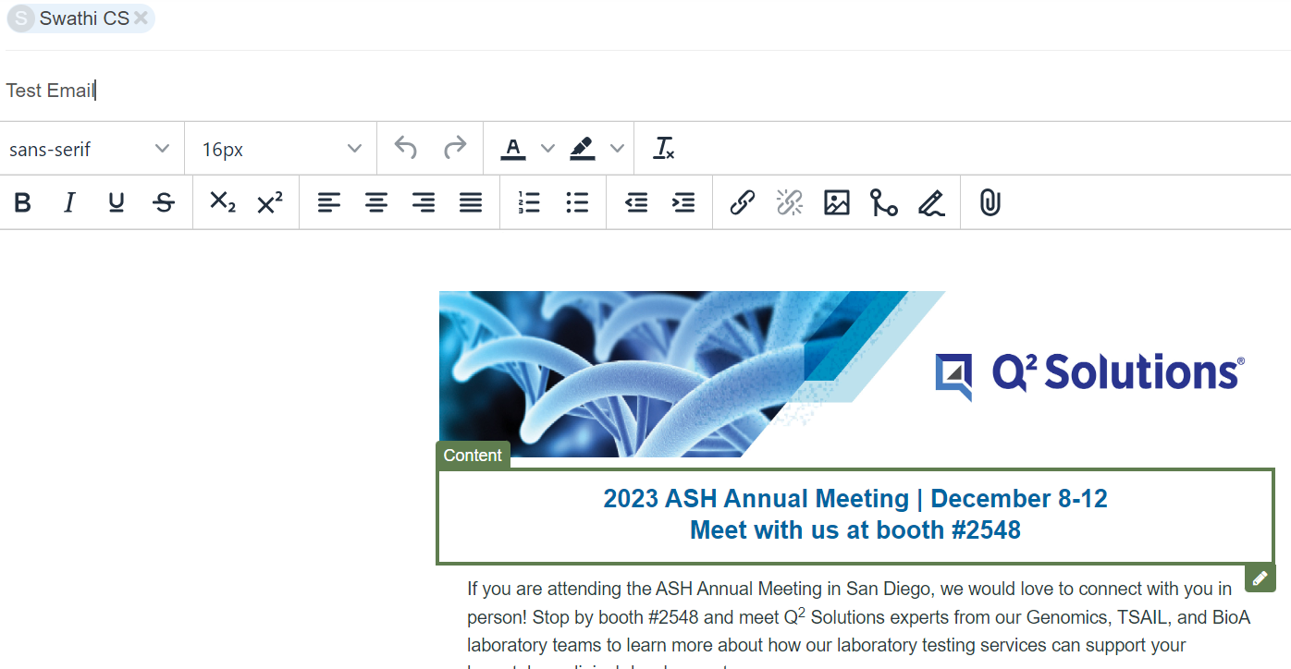
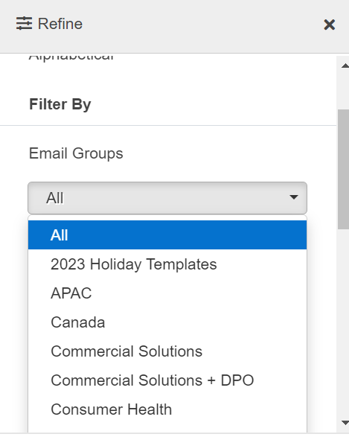
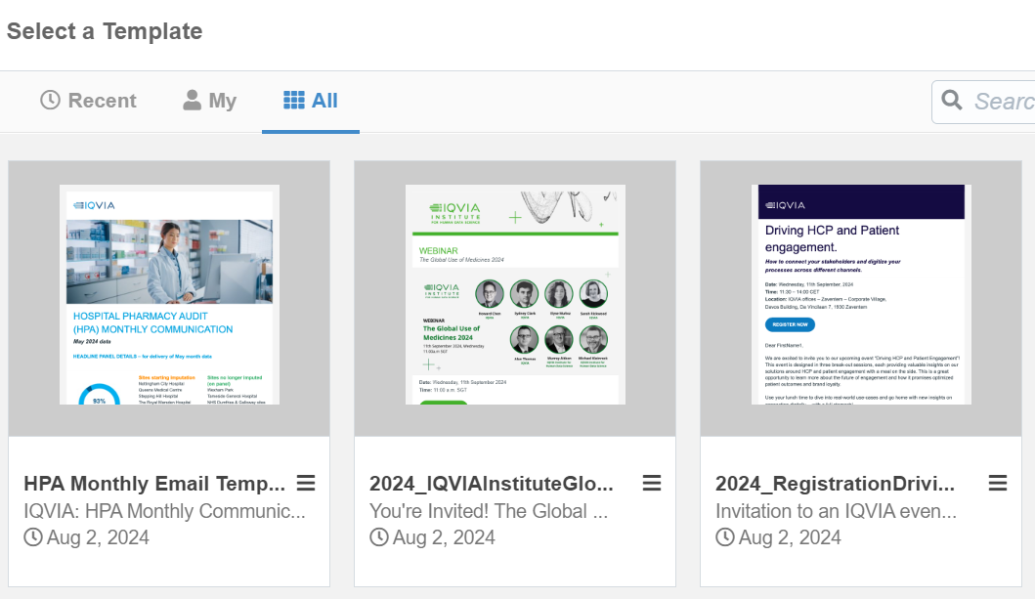
Eloqua Engage (embedded within Salesforce)
Sales can easily engage customers with consistent messaging and content
Provides Pre-built marketing templates that sales can easily customize to send personalized email
Email Templates: Pre-approved templates that sales teams can use to maintain consistency and professionalism.
Personalization: Allows for personalized content in emails, making them more relevant to the recipient.
Tracking and Analytics: Provides insights into email performance, including open rates, click-through rates, and more
.
It is typically best used for sales prospecting and for email sends to under 50 contacts.
Notes:
Eloqua Sales Tools consists mainly of Eloqua Engage and Eloqua Profiler. Eloqua Engage lives
within Salesforce and provides sales and marketing teams access to all of our marketing emails.
It is typically best used for sales prospecting and for email sends to under 50 contacts. Within
Eloqua Engage you are able to customize and send personalized emails through prebuilt
templates that already exist within Eloqua Engage. Emails that are sent out through Eloqua
Engage have the ability to track open and click-throughs in real time.
You can best use Eloqua Engage by making sales communications for your campaign to be used
as follow-up emails by Inside Sales or your sales teams.
For those of you who may already be familiar with engage I would like to note – Currently, a
new Outlook Plugin is being piloted by the Inside Sales group that makes it even easier to leverage Engage. And so far, the team is having good success engaging with these customers.

Slide 10
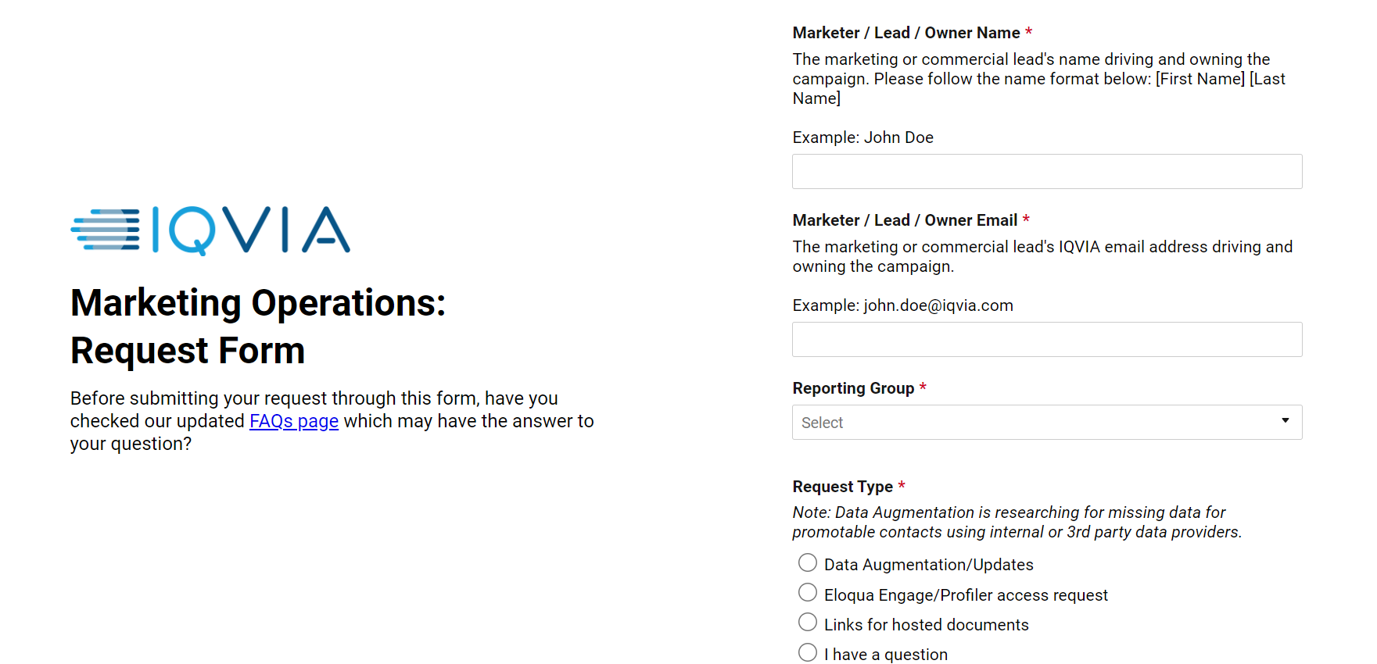
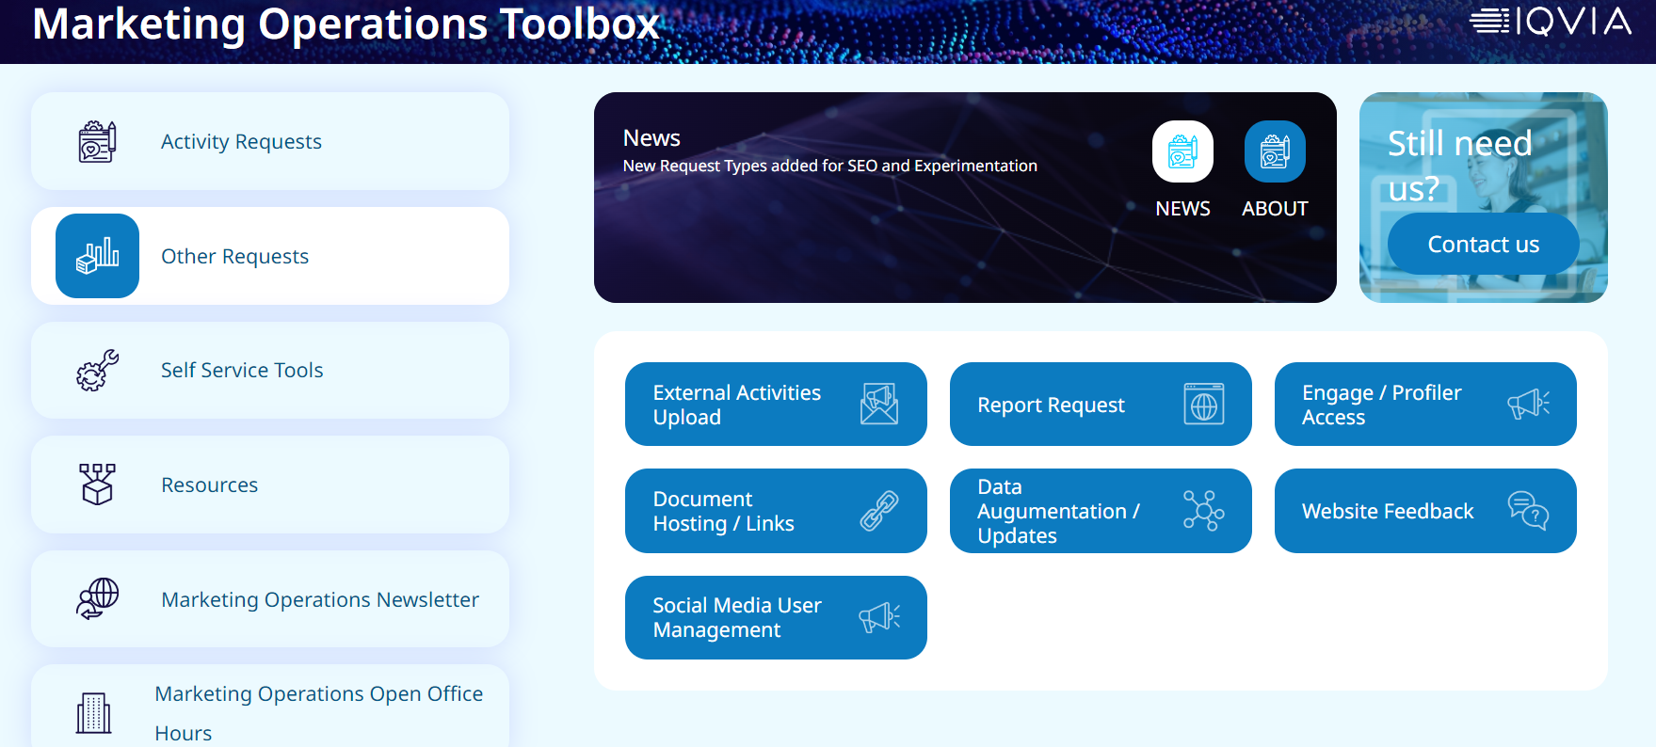
Use cases
IQVIA - Marketing Operations Toolbox
Sales Outreach: Quickly send personalized emails to prospects using pre-approved templates.
Follow-Up Emails: Automate follow-up emails after meetings or calls to keep the conversation going.
Event Invitations: Send out invitations for webinars, conferences, or other events with ease.
Product Announcements: Inform prospects and customers about new products or updates.
Customer Engagement: Maintain regular contact with customers to build and strengthen relationships

Slide 11
Eloqua Profiler

Slide 12
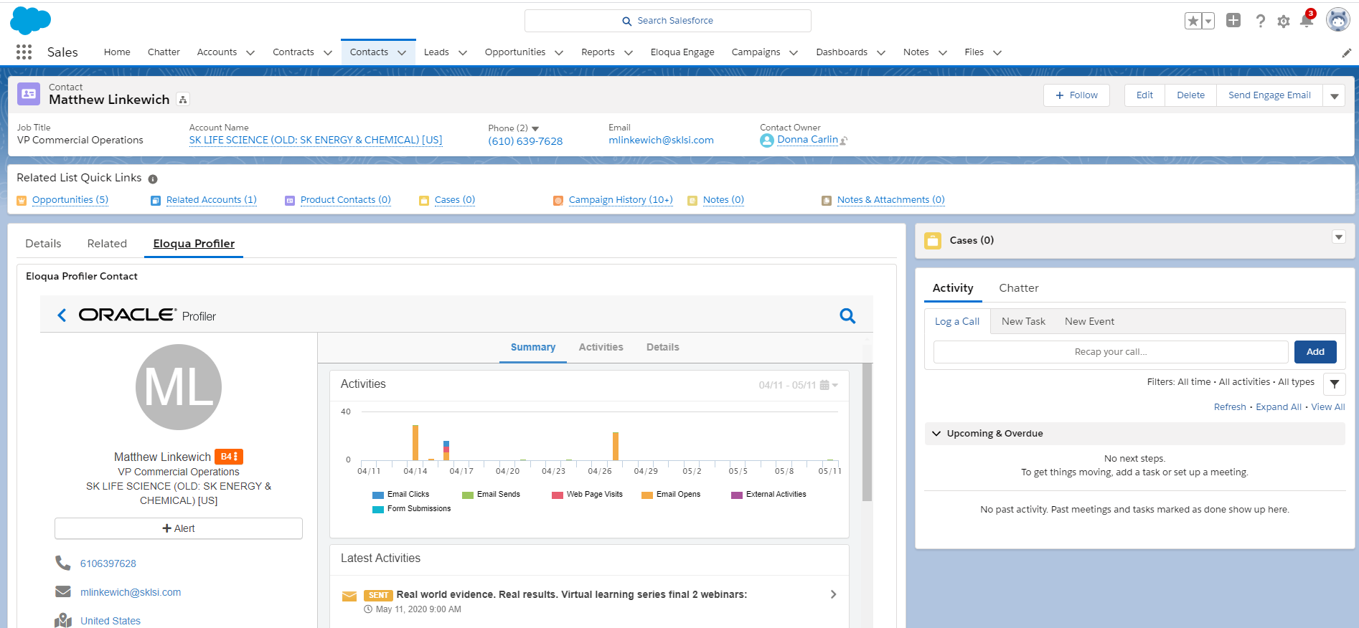
Profiler is Located on Salesforce Lead and Contact Records
Select this tab on the lead/contact layout to see this specific view

Slide 13
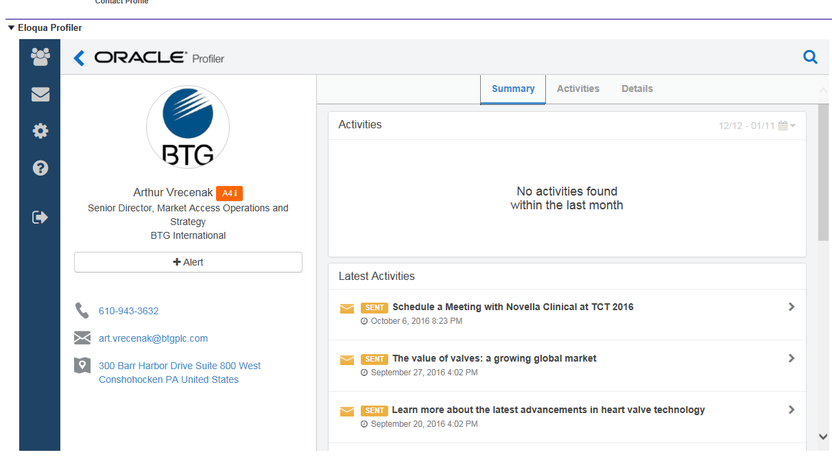
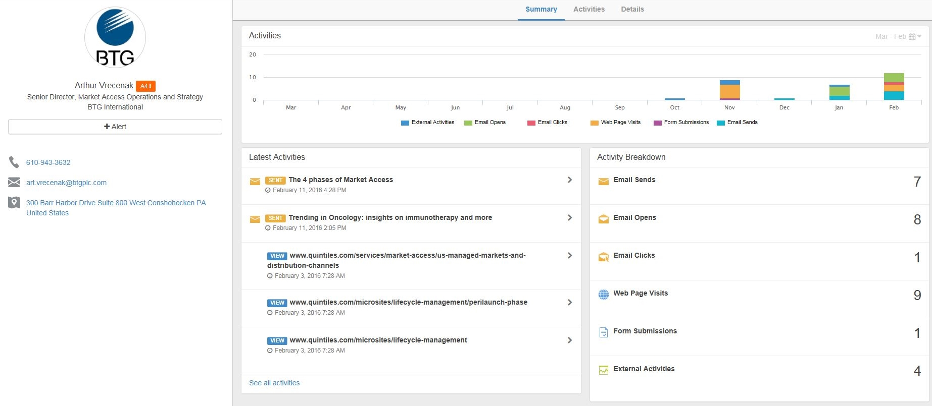
Scroll down on summary tab to view latest activities
You can view what emails a contact has received/opened, which web pages they have visited and any webinars or events they have attended. To amend the time period use the calendar icon (last 30/60 days, or 1 year)

Slide 14
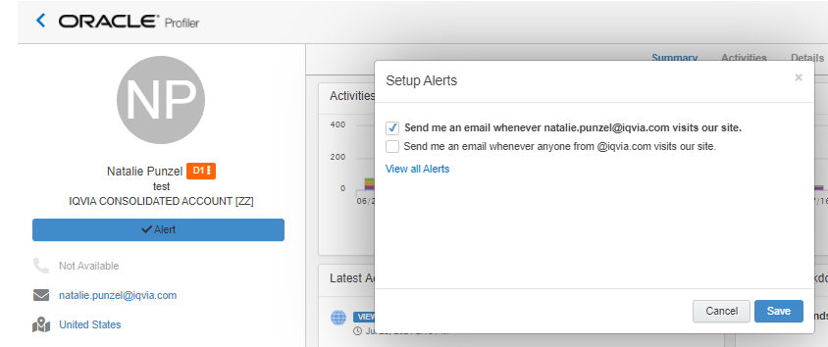
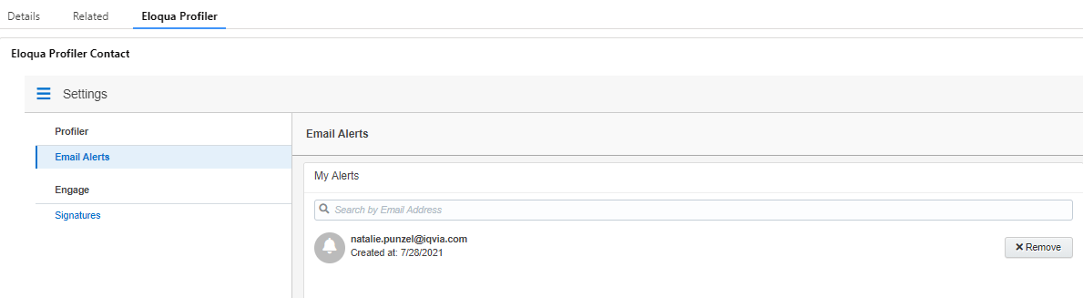
Eloqua Profiler Web Alerts
REMOVE ELOQUA PROFILER
WEB ALERTS
Search the contact you would like to remove as a web alert
Click on their name and select "Eloqua Profiler"
Click the blue "Alert" box
In the pop-up window select "View all Alerts"
Here all your web alerts will be listed, remove the alerts you no longer want to receive

Slide 15
Eloqua Engage

Slide 16
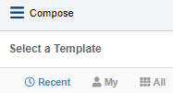
Eloqua Engage: Selecting a Template
ELOQUA ENGAGE: SELECTING A TEMPLATE
Log into Salesforce
Navigate to Eloqua Engage
Click on “Compose”
Choose a template
  Recent | My | All
Navigate to All – Filter to find a specific template saved in a particular location
If you know the template name you can type it in. It may be helpful to provide the Sales team with your campaign code so that they can search the templates available to them for that campaign
  2021_CSMSDynDplyWbnrEmNur_USCAusa_SS
  Natalie Demo Email Template

Slide 17
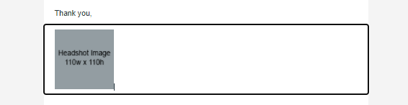
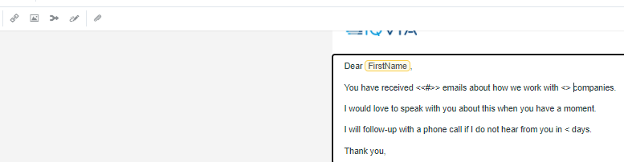

Eloqua Engage: Editing the Email
ELOQUA ENGAGE: EDITING THE EMAIL
Once you have selected your template, you can make edits to it
To delete a content block that you don’t want, simply highlight it and delete
To insert field content into the email, select Field Merge from the top ribbon banner
Here you can select, FirstName or Company if you desired that information to be pulled into the email
Here, you can preview your email to see what it would look like to the recipient

Slide 18

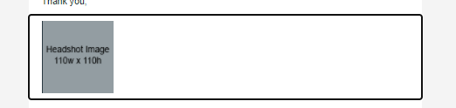
Eloqua Engage: Adding an Image
ELOQUA ENGAGE: ADDING AN IMAGE
If you would like to upload an image, put your cursor where you would like the image and select "Upload Image"
Select Upload in the right hand corner and upload the image you want to use
You will want to upload the image with the size dimensions desired, as you cannot alter the image size within Engage
The maximum size for an upload in Images is 50 MB

Slide 19

Eloqua Engage: Adding a file to your email
ELOQUA ENGAGE: ADDING A FILE TO YOUR EMAIL
We typically recommend sending a link to document vs having it attached in the email for tracking purposes.
In order to add a file to your email, Select the attachment icon in the editing banner
Select the attachment if it is already uploaded or select the upload button to upload your attachment
Insert the file as a tracked link
The maximum size for an upload in File Storage is 10 MB

Slide 20
Eloqua Engage: Adding New Contact Records
ELOQUA ENGAGE: AUDIENCE UPLOAD GUIDELINES
New contacts records can be created directly in Engage or Salesforce.
Salesforce and Eloqua Synch daily.
If a new contact is needed immediately for a delivery, enter the contact in Engage.
All new contacts need the following minimum information
  First Name
  Last Name
  Email Address
  Job Title
  Company
  Country
In the rare situation that you have a large number of contacts that need uploading, follow the process outlined here and send your file to marketing.automation@iqvia.com

Slide 21
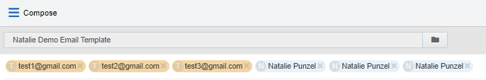
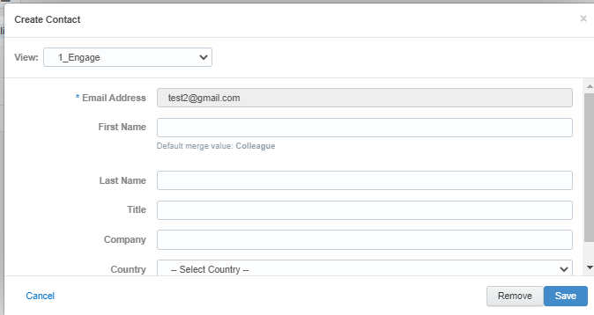
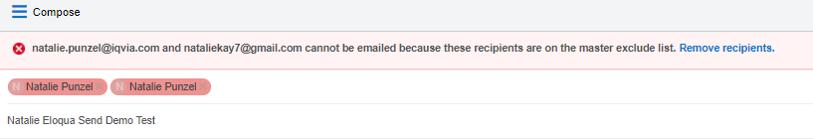
Eloqua Engage: Select the Audience
ELOQUA ENGAGE: SELECT THE AUDIENCE
To enter email addresses into the email, you can manually enter your recipients' email addresses or copy and paste contacts from Microsoft Outlook, as well as XLS and CSV files
As you enter an email recipient's name or email address, Engage searches your Oracle Eloqua contacts. If you enter an existing Oracle Eloqua contact, the name is displayed in blue. New email addresses that do not match Oracle Eloqua contacts, or ones missing a field merge value, display in orange. You are prompted to save these recipients as contacts before sending the email.
Engage displays warning messages if contacts are globally unsubscribed or if the email addresses are flagged as bouncebacks. These contacts are displayed in red. After clicking Send, Engage provides a list of any recipients who will not receive the email because they are either on the master exclude list or unsubscribed from the email group

Slide 22

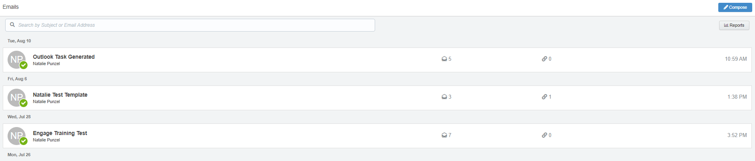
Eloqua Engage: Sending the email
ELOQUA ENGAGE: SENDING THE EMAIL
Once you have your audience selected, you can then go ahead and send your email
Once the email is sent, it will display on your Eloqua Engage homepage
On your Eloqua Engage homepage, you will be able to see engagement come in from your email in real time

Slide 23
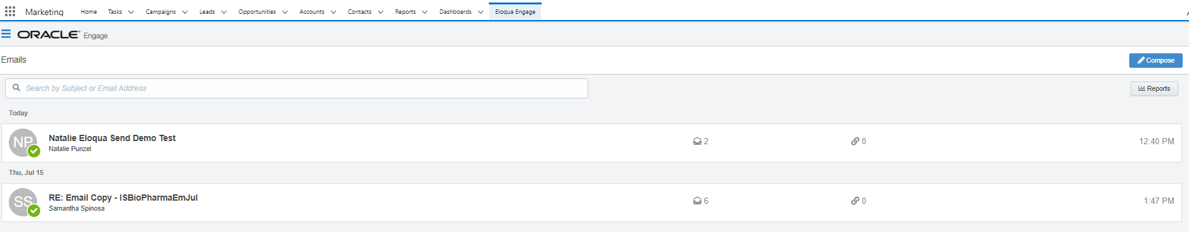
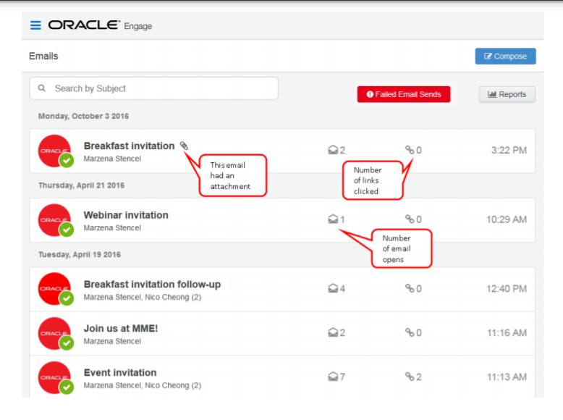
Eloqua Engage: Reporting
Once the email is sent, Engage displays your Recent Emails Sent history and send status.
To view email sent history:
  Navigate to the Engage home page by logging into Salesforce and clicking the Engage icon:
  Engage displays a list of successfully sent emails along with their sent status, date, and number of email opens and clicks.
    A green icon indicates the email was sent successfully to all recipients.
    An orange icon indicates the email was sent successfully to some recipients.
    A red icon indicates the email was not sent successfully to any recipients.

Slide 24
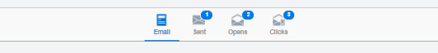
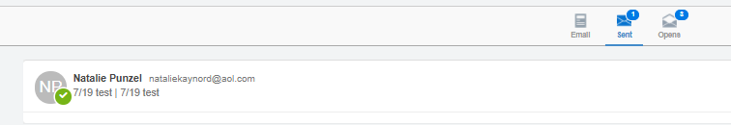
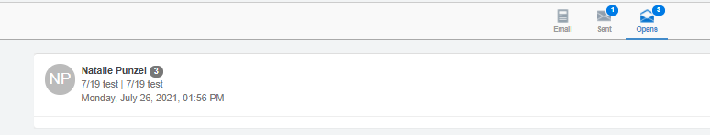
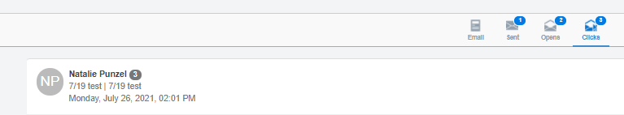
Eloqua Engage: Reporting
Select an email to view additional details. Explore the different tabs to learn more about your sent email.
Emails tab: Displays a thumbnail image of your email
Sent tab: Displays the recipients of the email. Here, you can click a recipient’s name to view additional details.
Opens tab: Displays the recipients who opened the email and
Clicks tab: Displays the recipients who clicked a link in the email

Slide 25
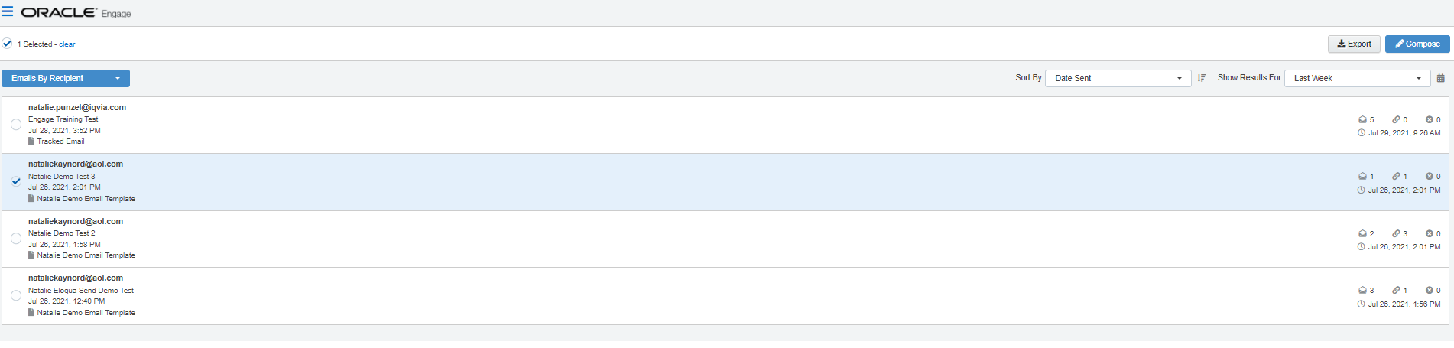
Eloqua Engage: Reports
Engage reports provide insight about the performance of your sent emails. Access reports by opening Engage and clicking Reports on the sent emails page
  Tip: You can send an email using one of the templates in your report results.
There are two Engage report types available:
  Engage top templates report
    The Engage top templates report provides information about the performance of your templates over a given period.
    You can utilize this report to gain an understanding of your top performing templates. You are than able to reuse the templates that have the best performance for future emails
  Engage emails by recipient report
    The report displays a list of recipients for your sent emails. Emails sent to multiple recipients are listed individually.
    You can utilize this report to view who has engaged with your email and follow up with them easily if desired. You can click on the recipient's name and select "Compose" to follow up directly with any recipient within this report.

Slide 26
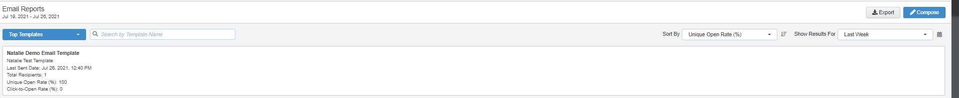
Eloqua Engage: Top Templates Report
The Top Templates report displays emails sent by the logged-in user
Use the search and date picker to limit the number of templates displayed:
  Search by template name.
  Filter results by date sent. Use the standard time frames from the drop-down list or enter a custom date by clicking the calendar icon. The default time frame is the Last Week.
Results are sorted by highest unique open rate by default. Use the Sort By drop-down list to sort by a different metric.
This report captures the following metrics.
  Unique Open Rate
    The unique opens divided by the total number of times an email was delivered. (Unique Opens / Total Delivered) A unique open is the number of recipients (original recipients or email forwards) that opened an email at least once. This does not count all the times that the same recipient opened the email.
  Click-to-open rate
    Clicked sends / opened sends. Both clicked sends and opened sends ignore possible forwards. Clicked sends: The first clickthrough by the original recipient. This metric ignores possible forwards. Opened sends: The number of first opens for the email.

Slide 27
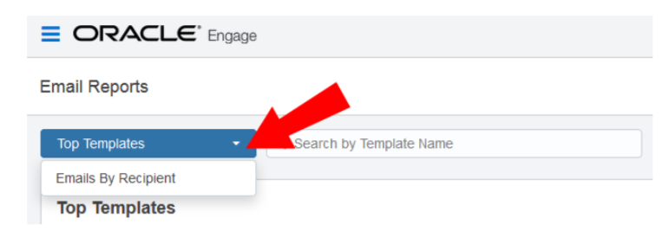
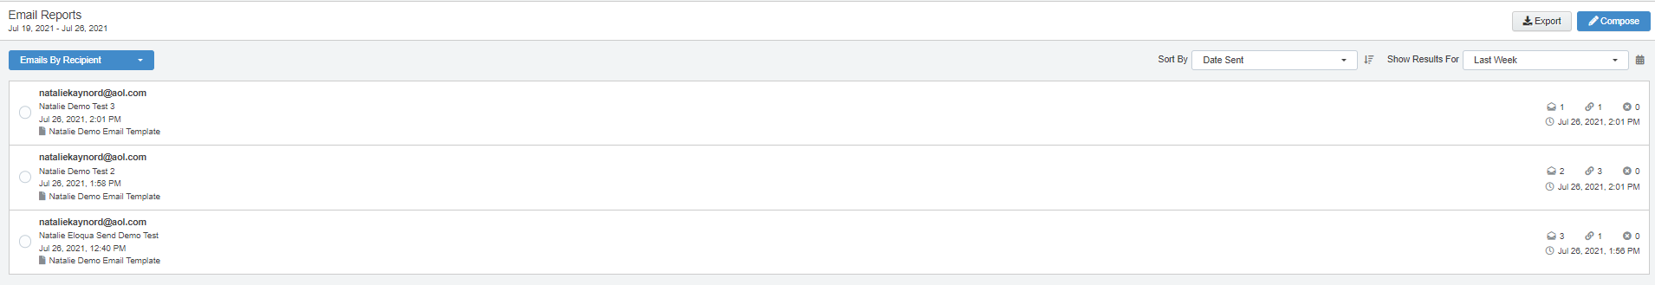
Eloqua Engage: Follow-up Using Top Recipient Report
The Top Recipient Report can be found in the Top Templates drop-down
Use the date picker to limit the number of email recipients displayed. Use the list’s standard time frames or enter a custom date by clicking the calendar icon. The default time frame is Last Week.
Results are sorted starting with the most recently sent email by default. Use the Sort By drop-down to sort by a different metric.
This report captures the following metrics.
  Total opens
    The number of times an email was opened. This includes multiple opens by the original recipient or forwarded recipient.
  Total clicks
    The total click-throughs. This includes multiple clicks by the same recipient. System Action links are not tracked.
  Hard bouncebacks
    The total emails that returned a hard bounceback.
    A hard bounce is an email that permanently could not be delivered. Some common reasons for hard bounces include an invalid email address or domain name.

Slide 28
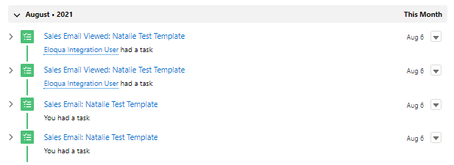
Eloqua Engage: Tasks Generated in Salesforce
When you do send your emails out of engage, the action counts as a “task.” Once the email is sent, a task will be created and marked as complete.
If the contact opens the email, another task will be created on the record that opened the email

Slide 29
RESOURCES
Eloqua Training Materials and Documentation
  Oracle Eloqua Engage User Guide
  Oracle Eloqua Sales Tools User Guide
  Profiler Training Resources
  Engage Training Resources
Training Videos
  Getting Started Video on Profiler (5 minutes)
  Eloqua Profiler Overview (3 minutes)
  Getting Started Video - Engage (3 minutes)
Eloqua Engage Outlook Plug-In
  Request the Oracle Outlook Plug-In in VIA
For any support needs for Engage or the Outlook Plug-in please submit a VIA ticket.

Slide 30
Thank You

